Slide 1
MATHEMATICS 2 M2.4: Probability
M2.4.C Permutations, Combinations, and Factorials
Yvonne V. Richardson

Slide 2
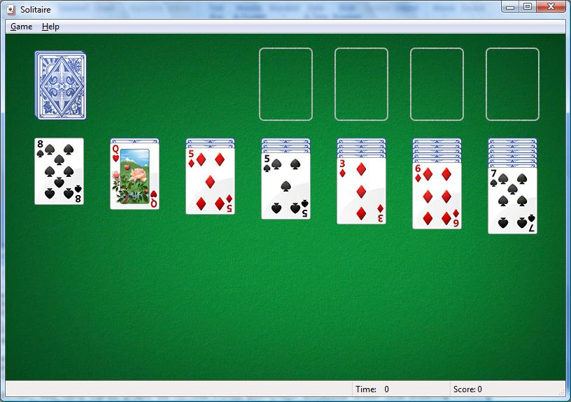
MATHEMATICS 2 M2.4: Probability
Solitaire
Permutations

Slide 3
MATHEMATICS 2 M2.4: Probability
Solitaire
Permutations

Slide 4
MATHEMATICS 2 M2.4: Probability
Solitaire
Permutations

Slide 5
MATHEMATICS 2 M2.4: Probability
Solitaire
Permutations
51 * 50

Slide 6
MATHEMATICS 2 M2.4: Probability
Permutations
51 * 50 * 49 * 48 * 47 * 46 =
approximately 1.3×1010; about 10 billion possibilities!

Slide 7
MATHEMATICS 2 M2.4: Probability
Permutations
51!
⎯
45!

Slide 8
MATHEMATICS 2 M2.4: Probability
Permutations
51 * 50 * 49 * 48 * 47 * 46 * 45!
⎯⎯⎯⎯⎯⎯⎯⎯⎯⎯⎯⎯⎯⎯⎯⎯
45!

Slide 9
MATHEMATICS 2 M2.4: Probability
Permutations
51 * 50 * 49 * 48 * 47 * 46 * 45!
⎯⎯⎯⎯⎯⎯⎯⎯⎯⎯⎯⎯⎯⎯⎯⎯
45!

Slide 10
MATHEMATICS 2 M2.4: Probability
Permutations
51 * 50 * 49 * 48 * 47 * 46

Slide 11
MATHEMATICS 2 M2.4: Probability
n!
⎯⎯
(n-k)!
n = the number of events
k = the number of items chosen
Permutations

Slide 12
MATHEMATICS 2 M2.4: Probability
n!
⎯⎯
(n-k)!
⎯⎯⎯⎯⎯⎯⎯⎯⎯⎯⎯⎯
k!
n = the number of events
k = the number of items chosen
Combinations
(
(

Slide 13
MATHEMATICS 2 M2.4: Probability
n!
⎯⎯
(n-k)! * k!
n = the number of events
k = the number of items chosen
k = the number of ways k items can be ordered
Combinations

Slide 14
MATHEMATICS 2 M2.4: Probability
n
k
n = the number of events
k = the number ways k items can be ordered
Probability
(
(

Slide 15
MATHEMATICS 2 M2.4: Probability
60!
⎯⎯
(54)! * 6!
n = the number of events
k = the number of items chosen
k = the number of ways k items can be ordered
Probability

Slide 16
MATHEMATICS 2 M2.4: Probability
60!
⎯⎯
(54)! * 6!
n = the number of events
k = the number of items chosen
k = the number of ways k items can be ordered
Probability

Slide 17
MATHEMATICS 2 M2.4: Probability
60 * 59 * 58 * 57 * 56 * 55
⎯⎯⎯⎯⎯⎯⎯⎯⎯⎯⎯⎯⎯
6 * 5 * 4 * 3 * 2
Probability

Slide 18
MATHEMATICS 2 M2.4: Probability
36,045,979,200
⎯⎯⎯⎯⎯⎯⎯⎯⎯⎯⎯⎯⎯
720
Probability

Slide 19
MATHEMATICS 2 M2.4: Probability
50,063,860
Chances of winning the lottery are 1 in 50,063,860
Probability

Slide 20
MATHEMATICS 2 M2.4: Probability
M2.4.C Permutations, Combinations, and Factorials
Yvonne V. Richardson

